Slide 1

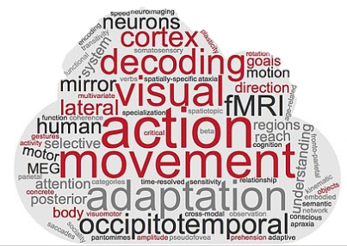
RSA: Whole-brain searchlight Day 3rd
Tonghe & Zuza

Slide 2
Overview
Basics of whole-brain searchlight based RSA
Example applications
Hands-on: RSA step by step with codes

Slide 3
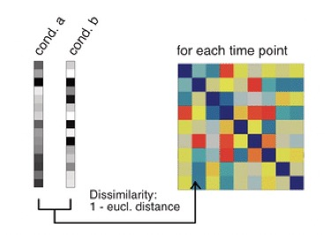
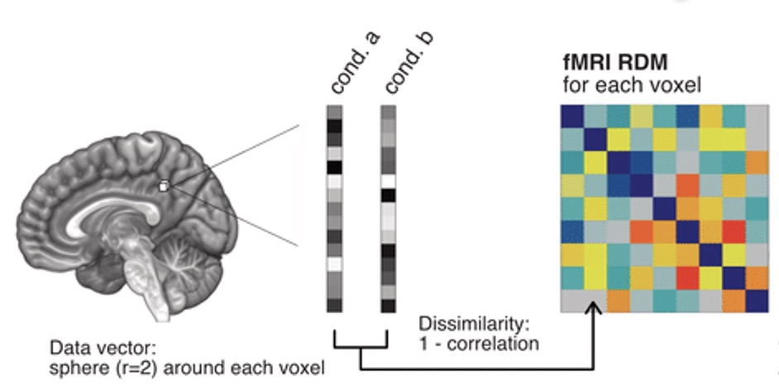
Basics of whole-brain searchlight based RSA
Bayer et al., 2021 Rapid neural representations of personally relevant faces

Slide 4
Neighborhood
Radius: xx mm.
Xx voxels nearest to the center voxel.

Slide 5
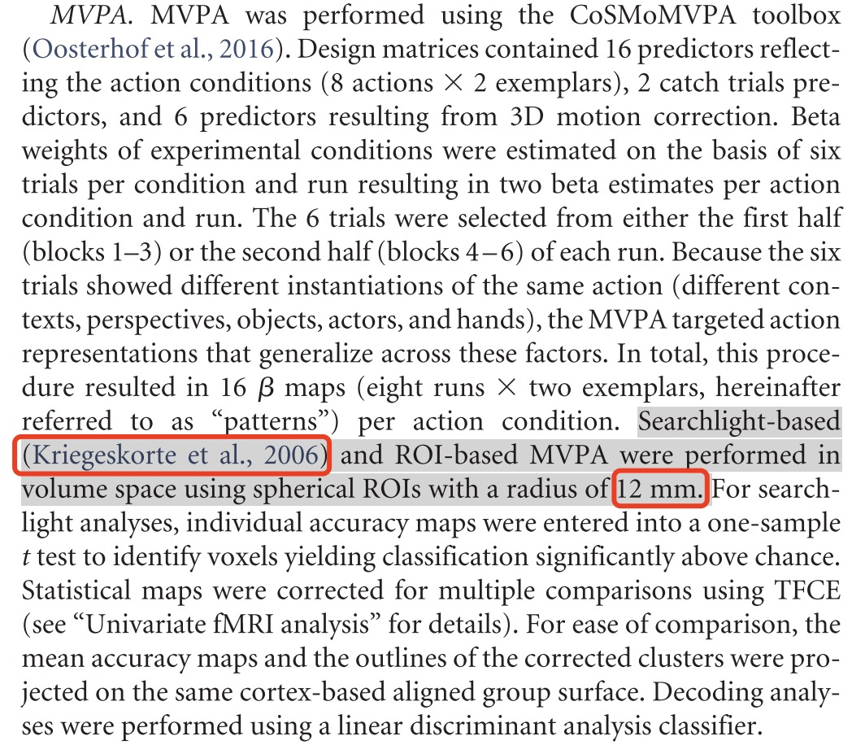
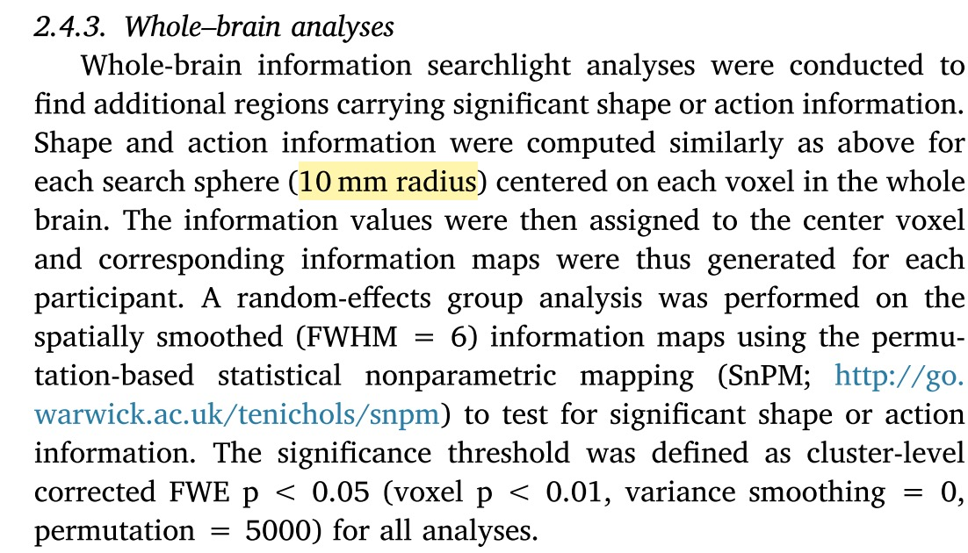
Neighborhood-radius
Wang, Zhuang, Shen, Bi, 2018 Neuropsychologia
Wurm et al., 2017 JN

Slide 6
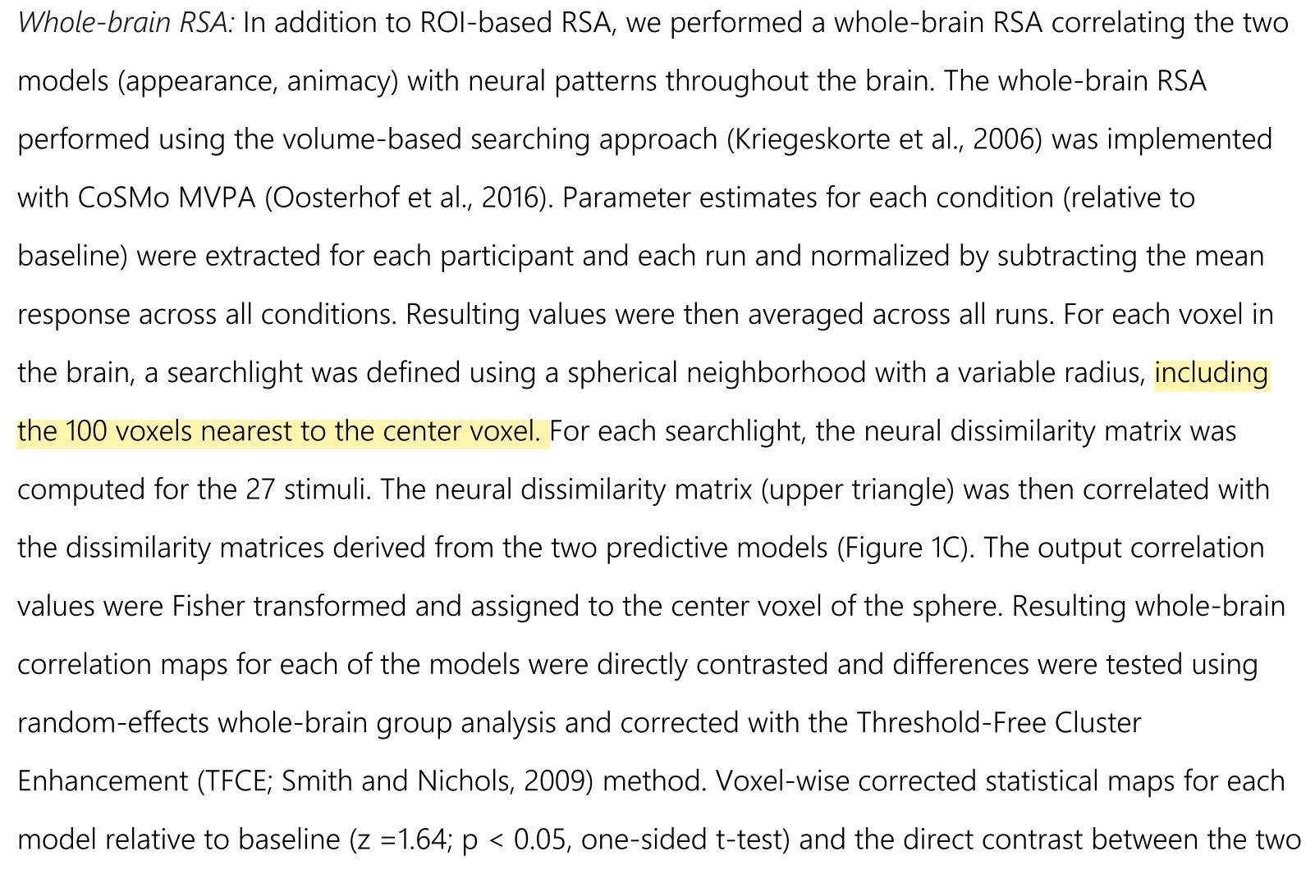
Neighborhood-Xx voxels nearest to the center voxel.
Bracci et al., 2019 JN

Slide 7
Hands-on matlab step 1: Getting ready
The data used here is available from https://cosmomvpa.org/datadb-ak6-v0.3.zip
(This example uses the dataset from Connolly et al (2012)).
description of dataset
Six categories (monkey, lemur, mallard, warbler, ladybug, lunamoth) during ten runs in an fMRI study. Using the General Linear Model response were estimated for each category in each run, resulting in 6*10=60 t-values.

Slide 8
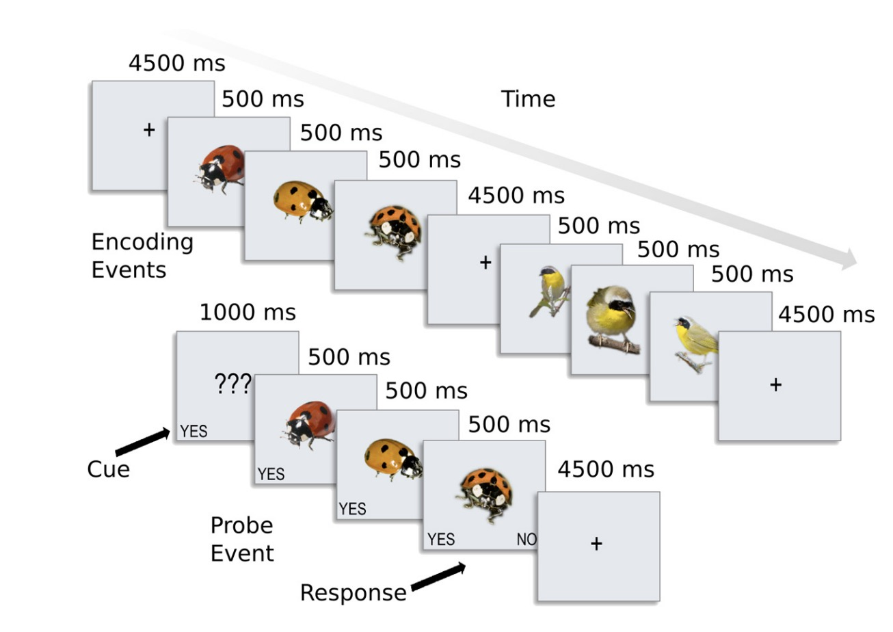
Aim: to investigate fine-grained category structure for a set of animal classes.
Behavioral similarity judgments: to “choose the odd-one-out” given a set of three animals.
V1 model similarity structure: low-level visual properties such as retinotopic shape biases and spatial frequency information based on a model of V1 cortical neurons (Serre et al., 2007)..
Design

Slide 9
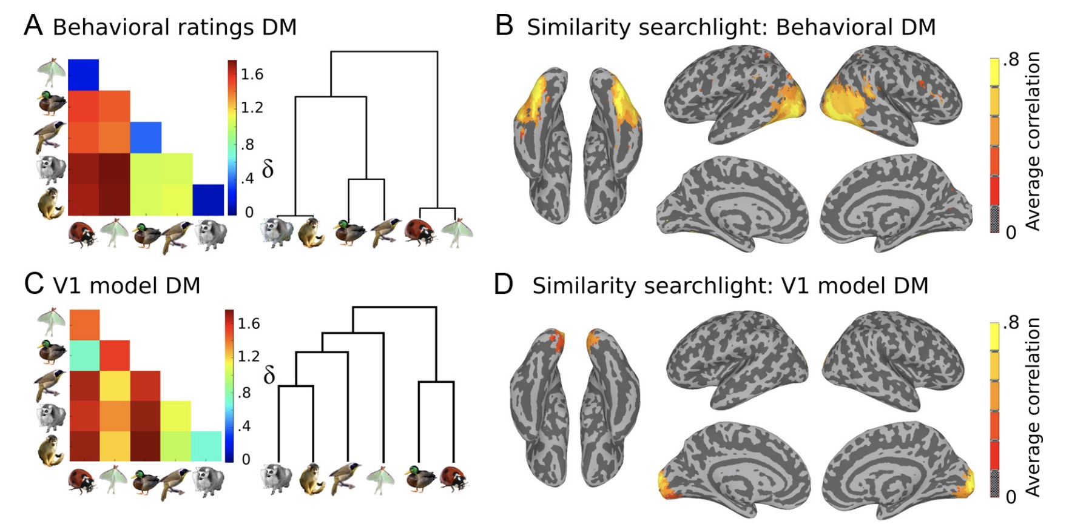
RSA searchlight results

Slide 10
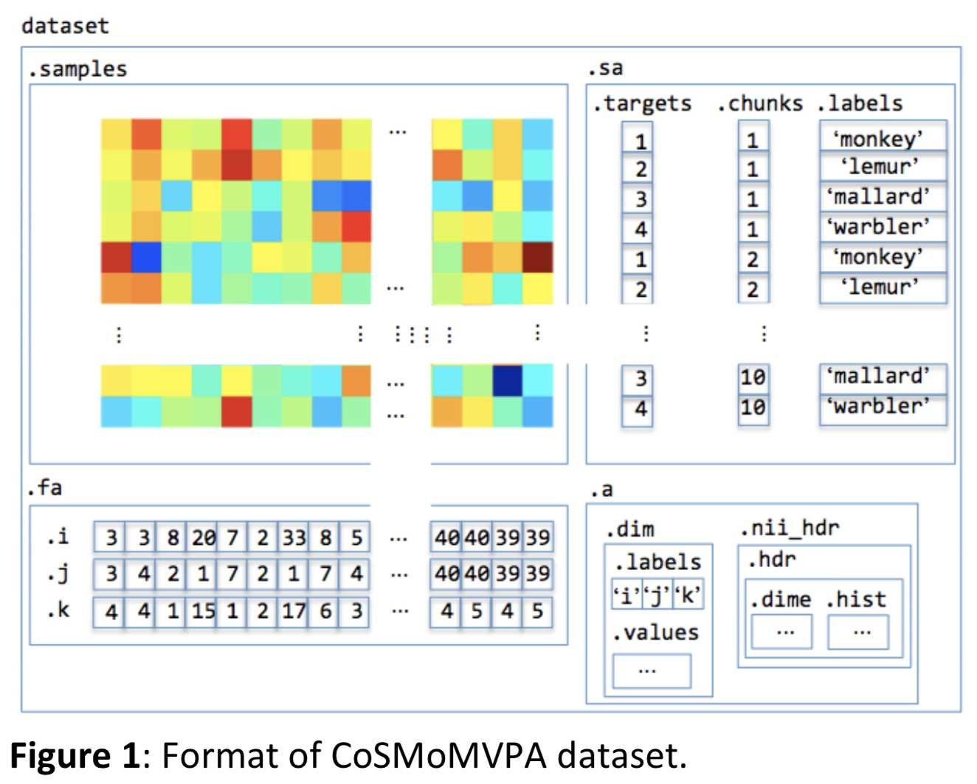
Step 2: Have a look at the format of the CoSMoMVPA dataset:

Slide 11
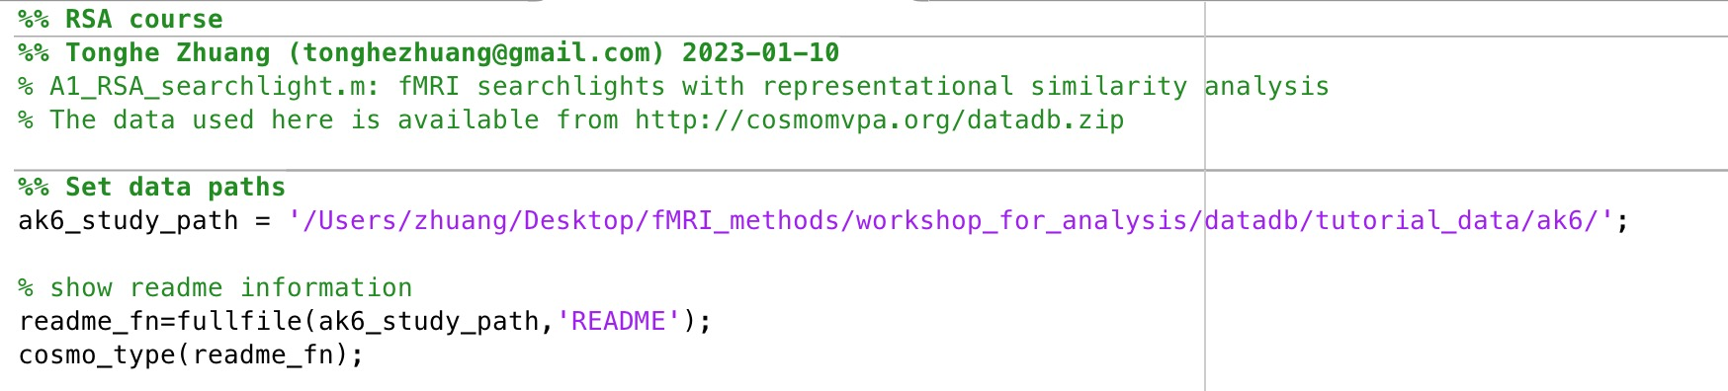
Step 3: Starting the exercises

Slide 12
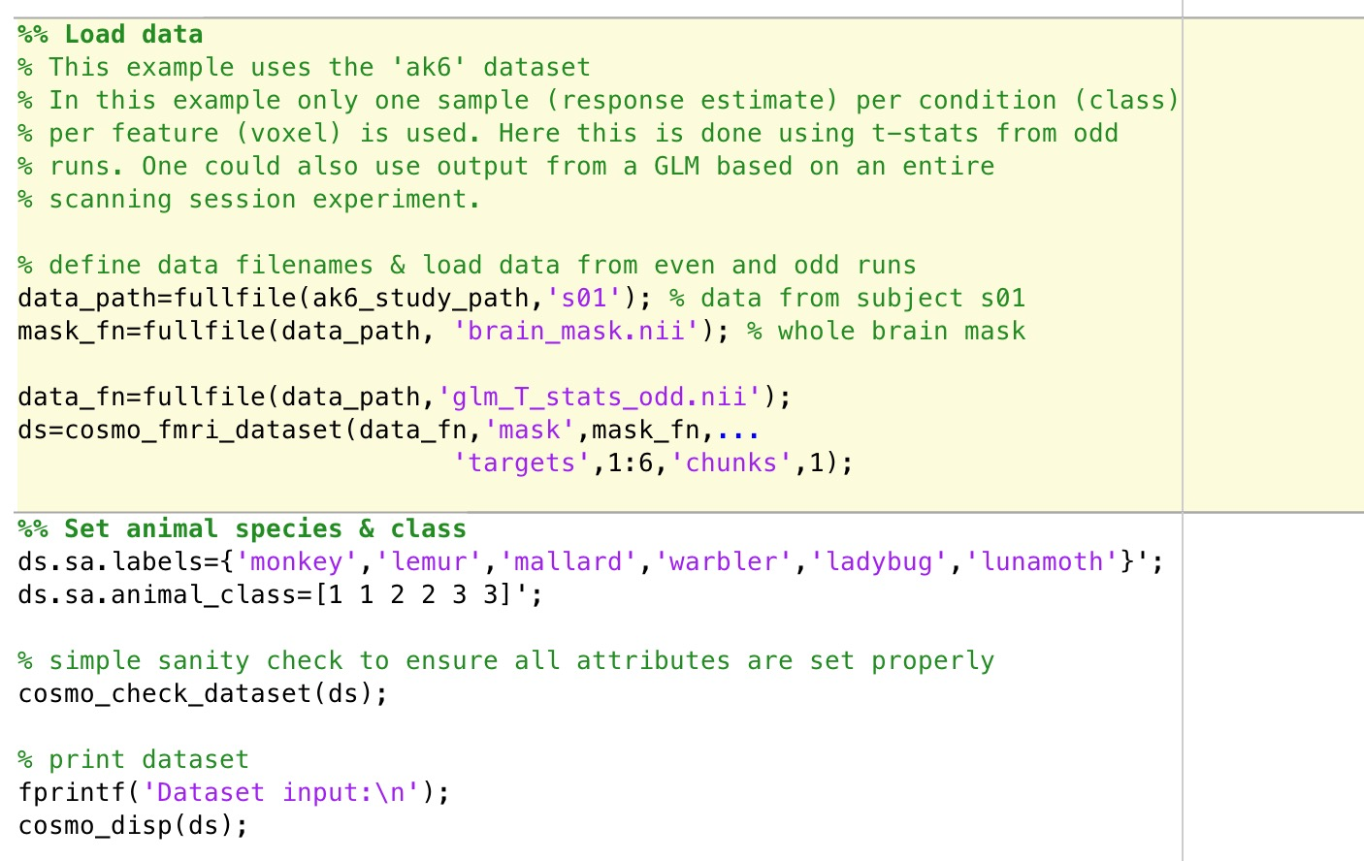

Slide 13
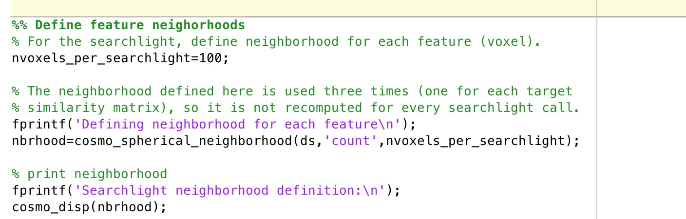

Slide 14
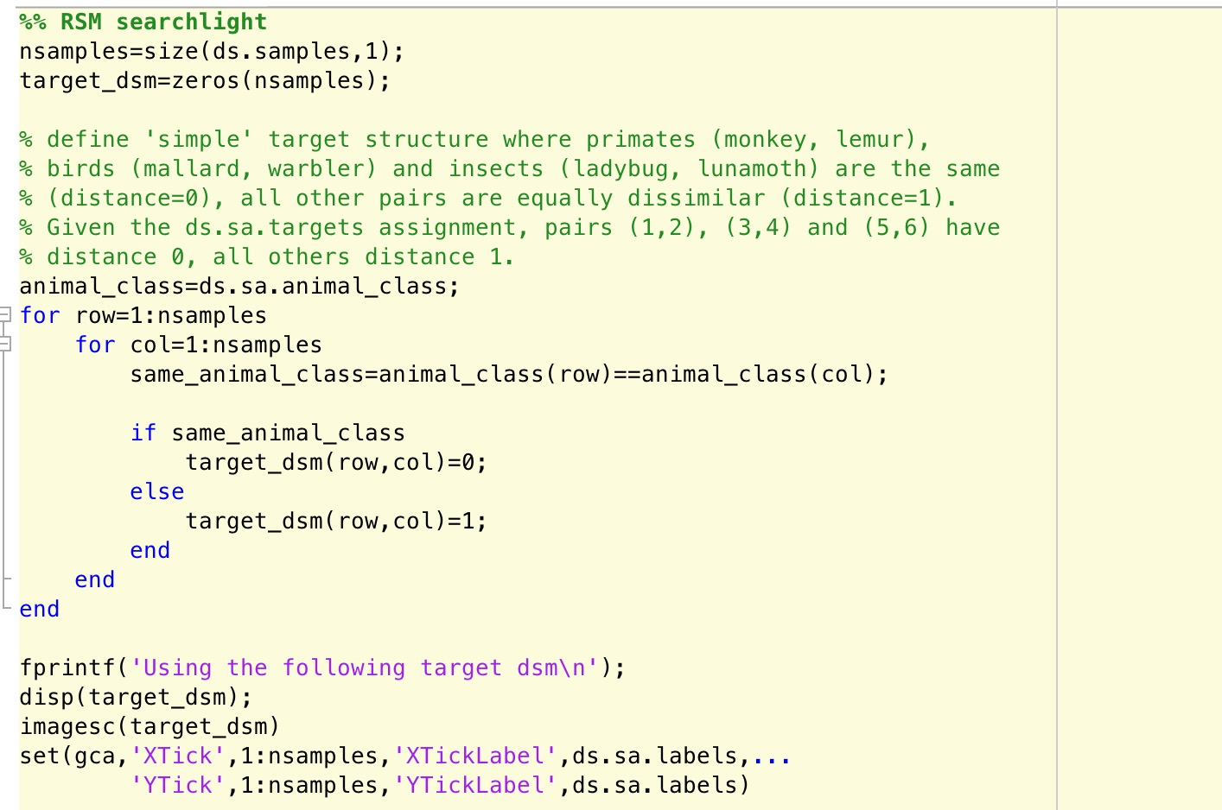

Slide 15
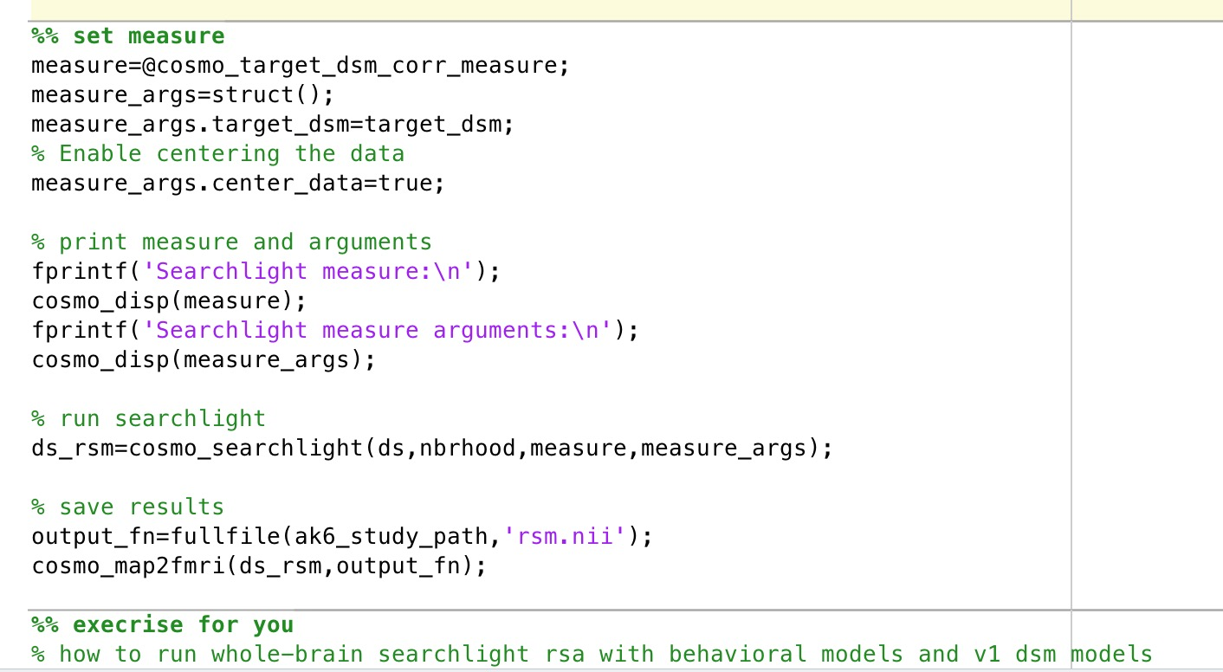

Slide 16
RSA: statistics for searchlight RSA Day 3rd
Tonghe & Zuza

Slide 17
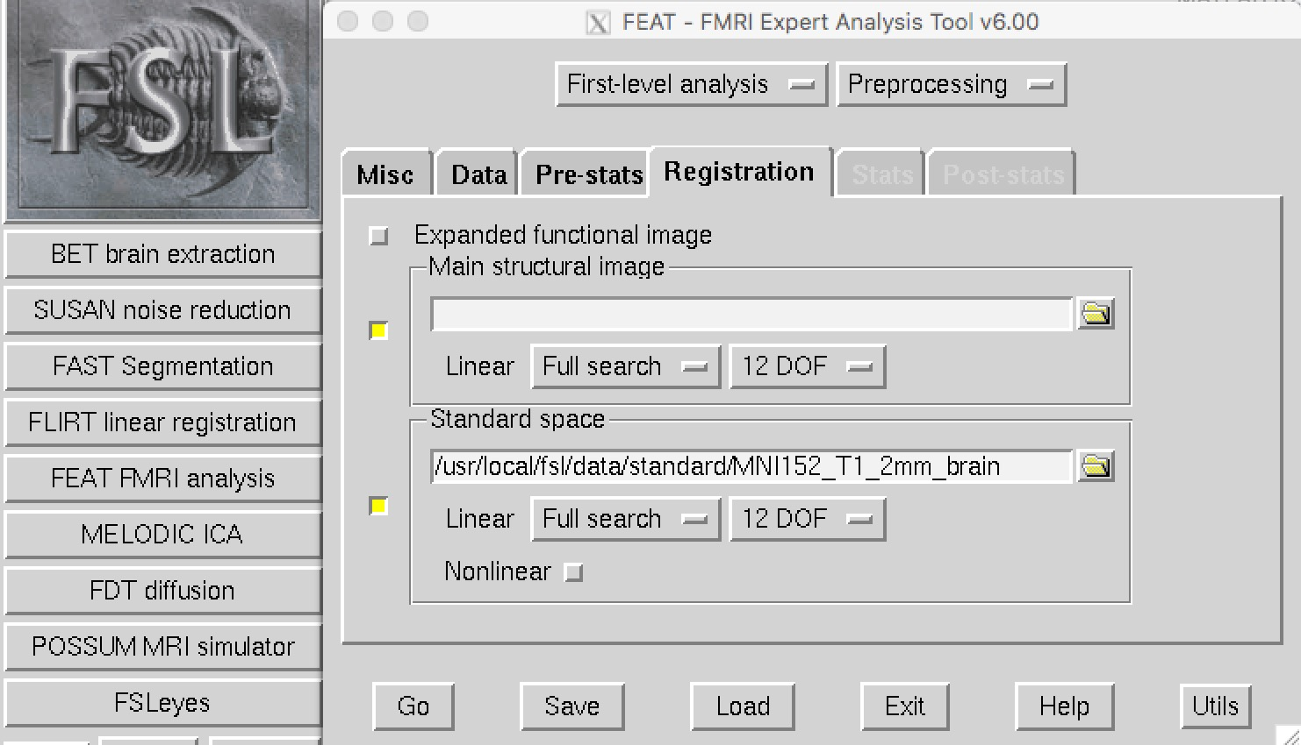
Convert individual data into standard MNI space
Registration

Slide 18
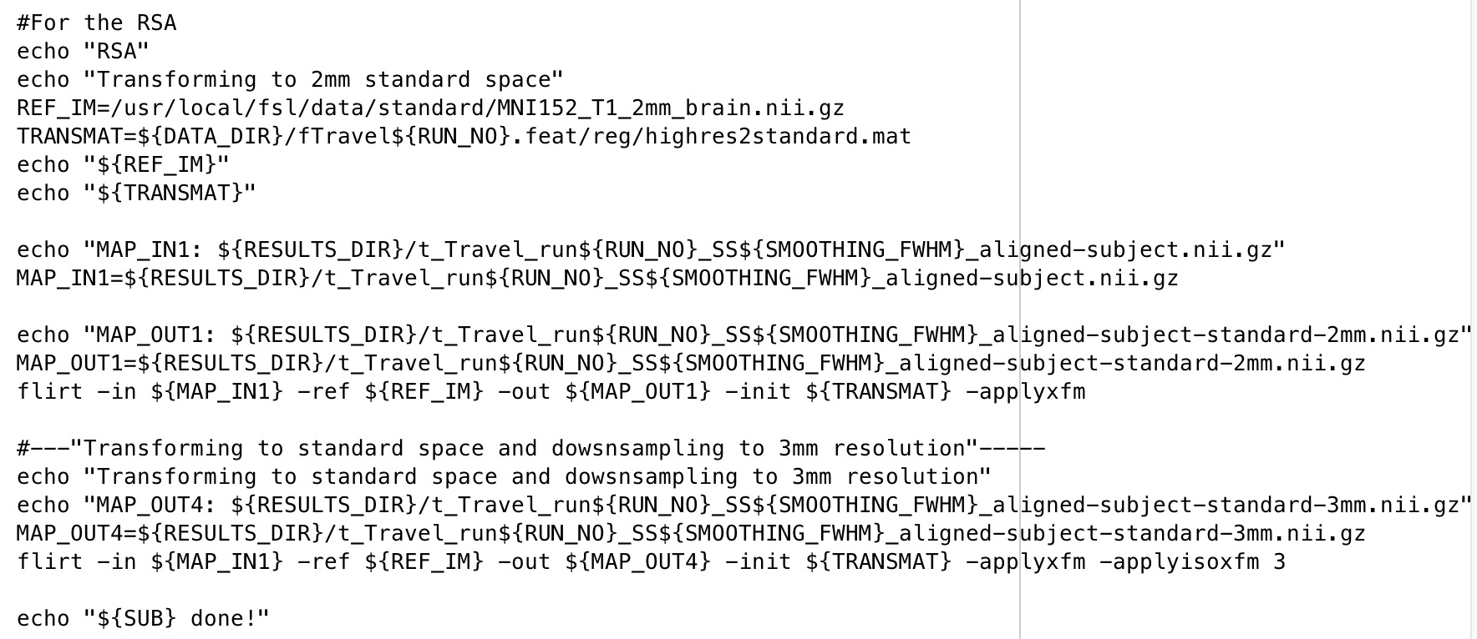
Convert individual data into standard MNI space

Slide 19
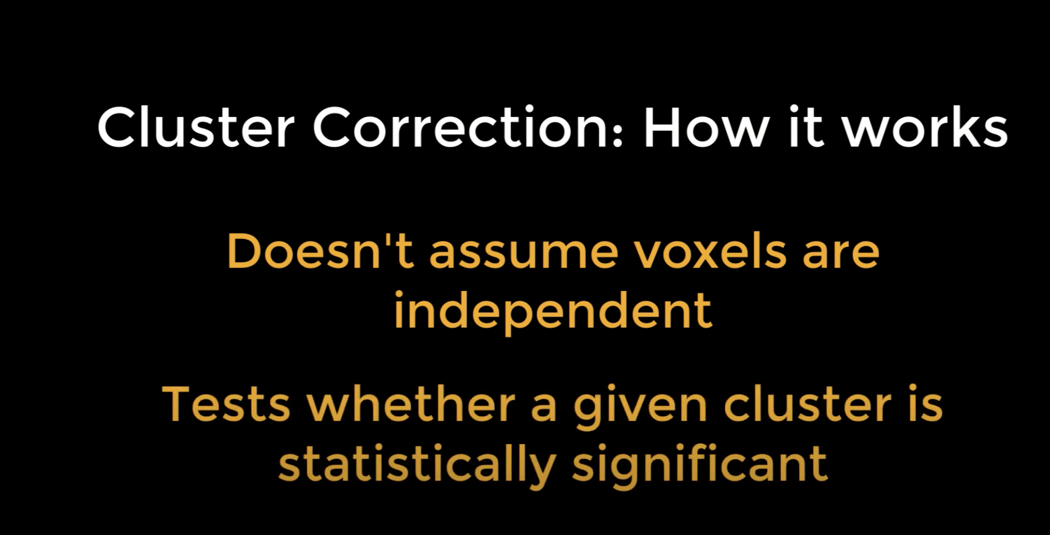
Cluster correction

Slide 20
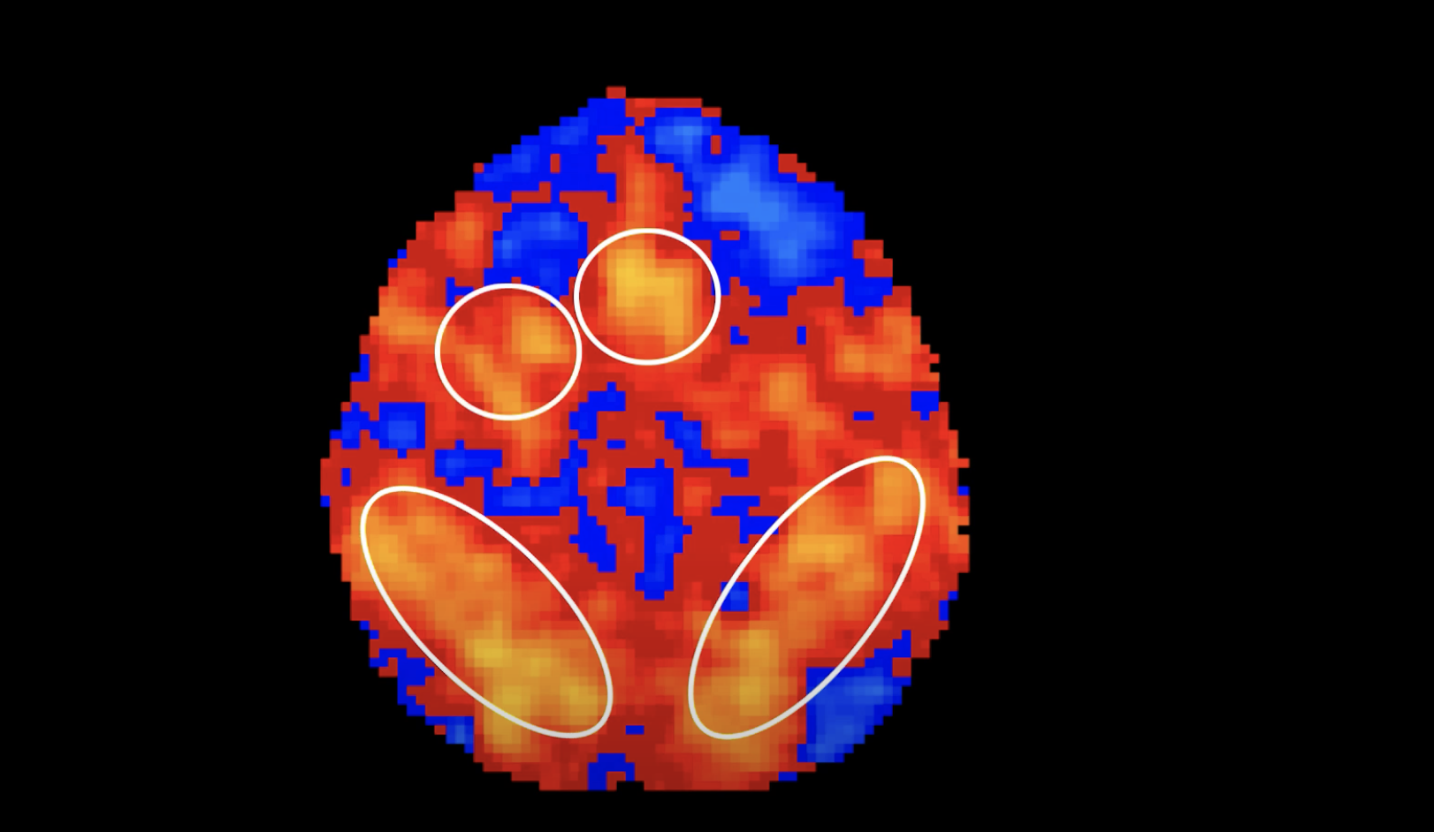
Cluster correction

Slide 21
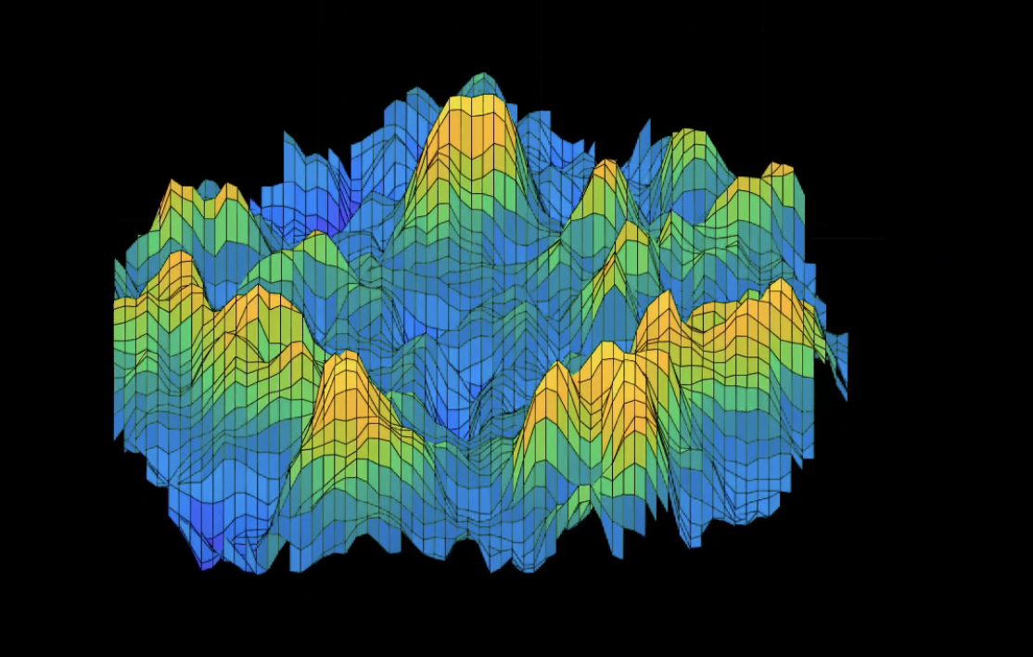
Cluster correction

Slide 22
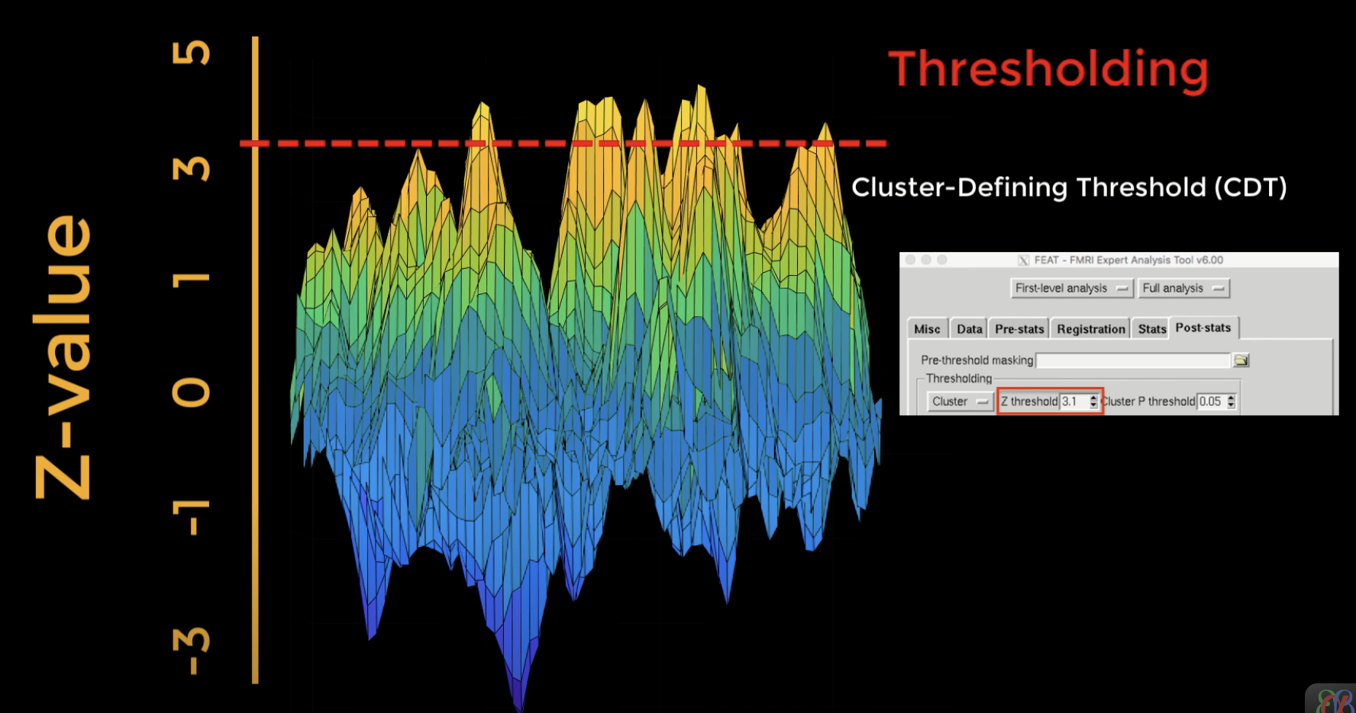
Cluster correction

Slide 23
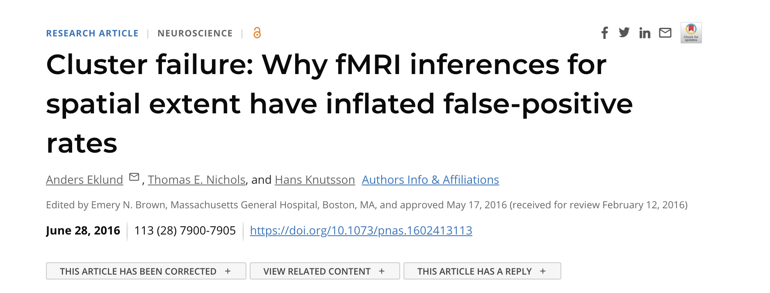

Slide 24
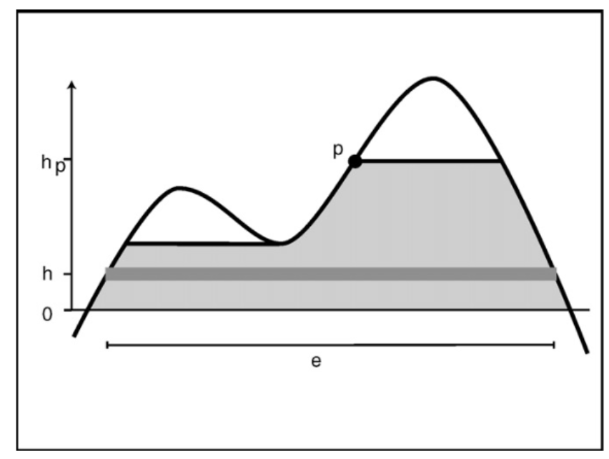
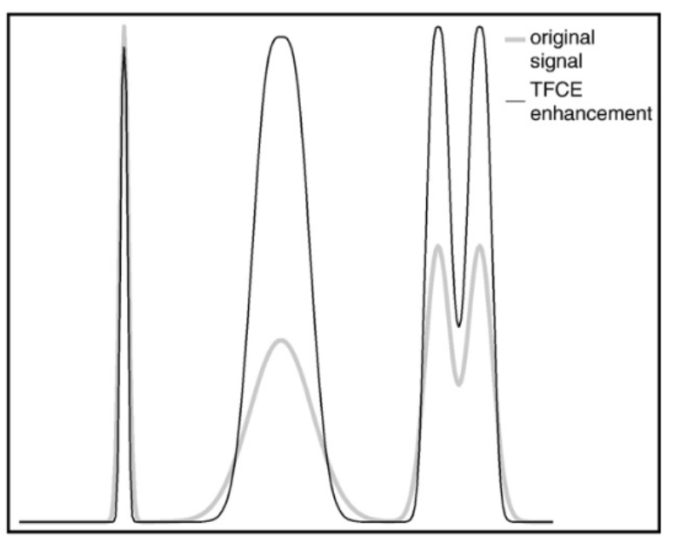

Threshold free cluster enhancement (TFCE)

Slide 25
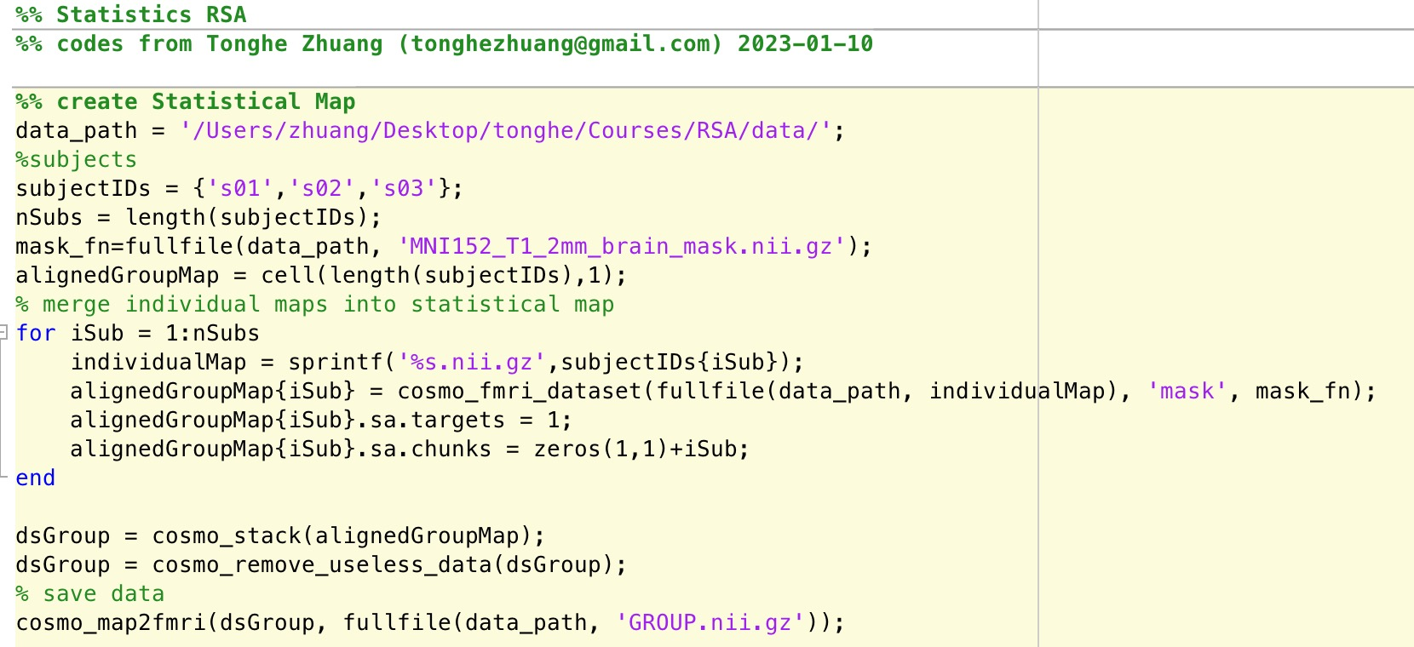
Statistics
Step 1: create statistical map

Slide 26
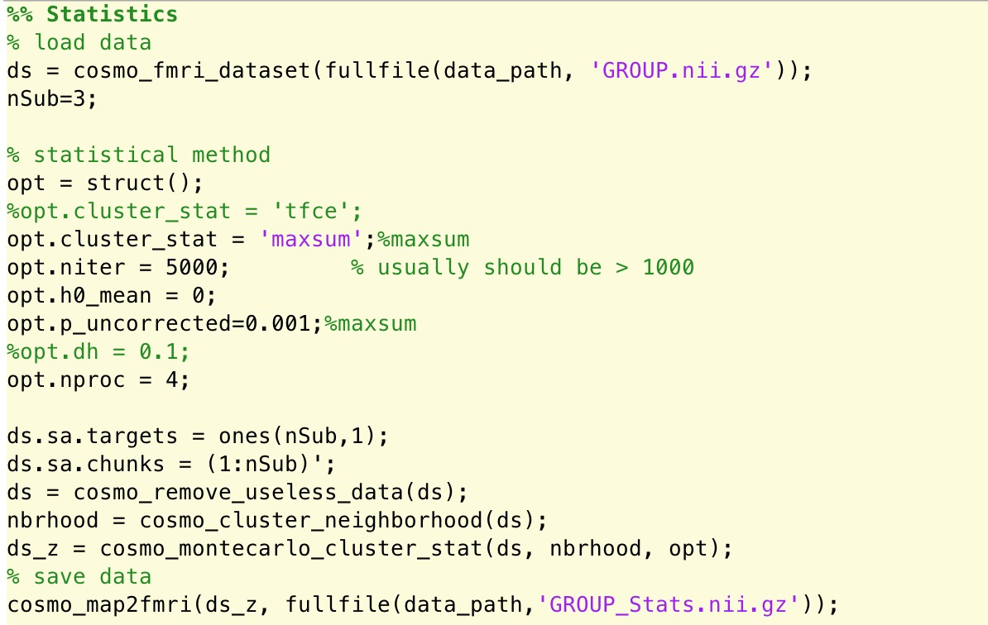
Statistics
Step 2: run statistics

Slide 27
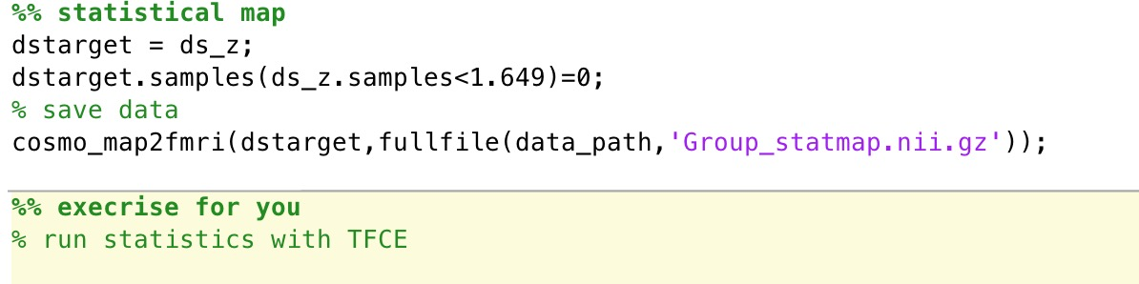
Statistics
Step 3: statistical map

